Slide 1
IE4803-REV:
Advanced Manufacturing Systems Modeling and Analysis
Fall 2023
Instructor: Spyros Reveliotis
e-mail: spyros@isye.gatech.edu
homepage: www.isye.gatech.edu/~spyros

Slide 2
“Course Logistics”
Office Hours: TR 10:30 - 11:45 or by appointment
Course Prerequisites: stochastic modeling (IE 3232, IE 3104).
Course grading policies:
  Homework: 20% (provided that we shall get a grader)
  Midterm I: 25%
  Midterm II: 25%
  Final Exam: 30%
  Academic Honor Code must be respected in all facets of the course
  Make-up exams and incompletes only in case of officially documented emergencies
Reading Materials:
  Course Textbook: G. L. Curry and R. M. Feldman, “Manufacturing Systems Modeling and Analysis” (2nd ed.), Springer, 2011
  Course slides and any other material posted at my homepage or circulated through CANVAS

Slide 3
Reading Assignment
Read Chapters 1 and 2 from your textbook.

Slide 4
Course Objectives
(What is this course all about?)
Introduce the students to an in-depth modeling and analysis of the workflow dynamics that shape the operation and the performance of contemporary production systems.
Offer the students the experience of applying their formal background in stochastic modeling and analysis to practical problems and applications.
In fact, a further intention of the course is to teach the students not only the particular models and algorithms that are covered in it, but also the thinking processes and the broader methodology that underlie the development of the presented results.
Finally, while the course material will be motivated and presented primarily through applications drawn from the manufacturing domain, for specificity and concreteness, this material finds further applicability in any other application domain involving a structured workflow, like in health care and other service-related industries.

Slide 5
Our abstraction of the Production System
The production system as a transformation process (physical, locational, physiological, intellectual, etc.)
Inputs
Outputs
Materials
Capital
Labor
Manag. Res.
Goods
Services
Organization
The production system as a process network
Stage 1
Stage 2
Suppliers
Stage 4
Customers
Stage 3
Stage 5

Slide 6
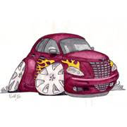
Discrete Part Manufacturing Systems
The end product is the
assemblage of a
number of components
and sub-assemblies,
either produced in- house or procured from outside.
Frame
Building
Frame
Machining
Frame
Painting
Engines and
Transmissions
TESTING
Seats
Cell
Oil Tank
Cell
Steering
Wheel Cell
Shocks
Cell
Doors
Cell
Wheels
Cell
“Packaging”

Slide 7
Production Flow in discrete part manufacturing
Main Frame
Part 1
Process
Plan
O-1-1
O-1-2
O-1-3
O-1-4
A-1
Part 2
Process
Plan
A-2
O-2-1
O-2-2
O-2-3
Part 3
(Procured externally)
A-3
Part 4
Process
Plann
O-4-1
O-4-2
O-4-3
A-4
I-1
Part 5
Process
Plan
O-5-1
O-5-2
A-5
End Product

Slide 8
A typical Organization of the
Production Activity in
High-Volume Discrete-Part Manufacturing
Assembly Line 1: Product Family 1
Raw
Material
& Comp.
Inventory
S1,1
S1,2
S1,i
S1,n
Finished
Item
Inventory
Fabrication (or Backend Operations)
Dept. 1
Dept. 2
Dept. j
Dept. k
S2,1
S2,2
S2,i
S2,m
Assembly Line 2: Product Family 2

Slide 9
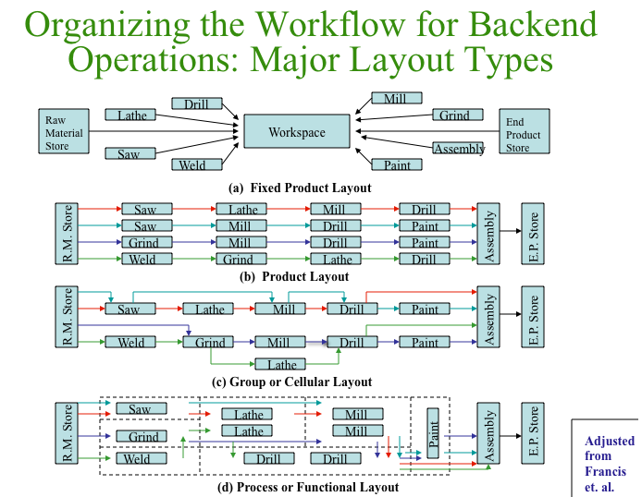

Slide 10
Fixed Product Layout
Workpiece remains fixed and the various processes are brought to it
Used primarily in ship-building.
Sometimes can be the preferred layout when high levels of precision are in order.
Production activity is controlled through project management related practices.

Slide 11
Product Layout or Flowline
Each part has its own dedicated production line.
The line for each part is organized in a way that facilitates the corresponding production flow.
Easy to manage and supervise
However, a capital-intensive proposition
Production volumes must be sufficiently large

Slide 12
Process Layout or Job Shop
Facility is organized into departments supporting different functions
Production lots are visiting these departments according to their processing needs (process plans)
Can result in high equipment utilization and operational flexibility
But it also incurs extensive material handling and long production times
Necessitates involved production planning and scheduling
Appropriate for low-volume production of a large, volatile portfolio of parts

Slide 13
Group or Cellular Layout
Parts are grouped into families based on the similarity of their processing requirements.
Each family gets a dedicated production facility, known as production cell.
Typically cells operate as switching flowlines, with switching taking place between the production of batches of different part types.
Frequently switching can involve substantial effort and time, known as setup time.
Provide a “middle ground” between a product and a process layout, in terms of operational efficiency and investment

Slide 14
Manufacturing Flowlines:
A working abstraction
Flow line: A sequence of workstations supporting the production of a single part type.
Each workstation consists of one or more identical servers executing one particular stage of the entire production process.
Processing time at each workstation is variable due to inherent process variability but also due to operational detractors, like
  machine downtime,
  operator unavailability,
  experienced set-up times,
  preventive maintenance, etc.

Slide 15
The major functional units of a modern organization
Strategic Planning:
defining the organization’s mission and
the required/perceived core competencies
Production/
Operations:
product/service
creation
Finance/
Accounting:
monitoring of
the organization
cash-flows
Marketing:
demand
generation
and
order taking

Slide 16
Corporate Mission
The mission of the organization
  defines its purpose, i.e., what it contributes to society
  states the rationale for its existence
  provides boundaries and focus
  defines the concept(s) around which the company can rally
Functional areas and business processes define their missions such that they support the overall corporate mission in a cooperative and synergistic manner.

Slide 17
Corporate Mission Examples
Merck: The mission of Merck is to provide society with superior products and services-innovations and solutions that improve the quality of life and satisfy customer needs-to provide employees with meaningful work and advancement opportunities and investors with a superior rate of return.
FedEx: FedEx is committed to our People-Service-Profit philosophy. We will produce outstanding financial returns by providing totally reliable, competitively superior, global air-ground transportation of high-priority goods and documents that require rapid, time-certain delivery. Equally important, positive control of each package will be maintained utilizing real time electronic tracking and tracing systems. A complete record of each shipment and delivery will be presented with our request for payment. We will be helpful, courteous, and professional for each other, and the public. We will strive to have a completely satisfied customer at the end of each transaction.

Slide 18
Defining the Corporate Strategy
Responsiveness (Reliability; Quickness; Flexibility;
e.g., Dell, Overnight Delivery Services)
Competitive Advantage through which
the company market share is attracted
Cost Leadership (Price;
e.g., Wal-Mart, Southwest
Airlines, Generic Drugs)
Differentiation (Quality; Uniqueness;
e.g., Luxury cars, Fashion Industry,
Brand Name Drugs)

Slide 19
Flowline Performance Measures
Production rate or throughput, i.e., the number of parts produced per unit time
Line capacity, i.e., the maximum sustainable production rate
Line (expected) cycle time, i.e., the average time that is spend by any part into the line (this quantity includes both, processing and waiting time).
Average Work-In-Porcess (WIP) accumulated at different stations
Expected utilization of the station servers.
Remark: The above performance measures provide a link between the directly quantifiable and manageable aspects and attributes of the line and the primary strategic concerns of the company, especially those of responsiveness and cost efficiency.

Slide 20
A flowline classification based on the applied workflow control scheme
Flowline
Synchronous
Asynchronous
Push
e.g.,
Asynchronous
Transfer
Line
Pull
e.g.,
KANBAN or
CONWIP lines

Slide 21
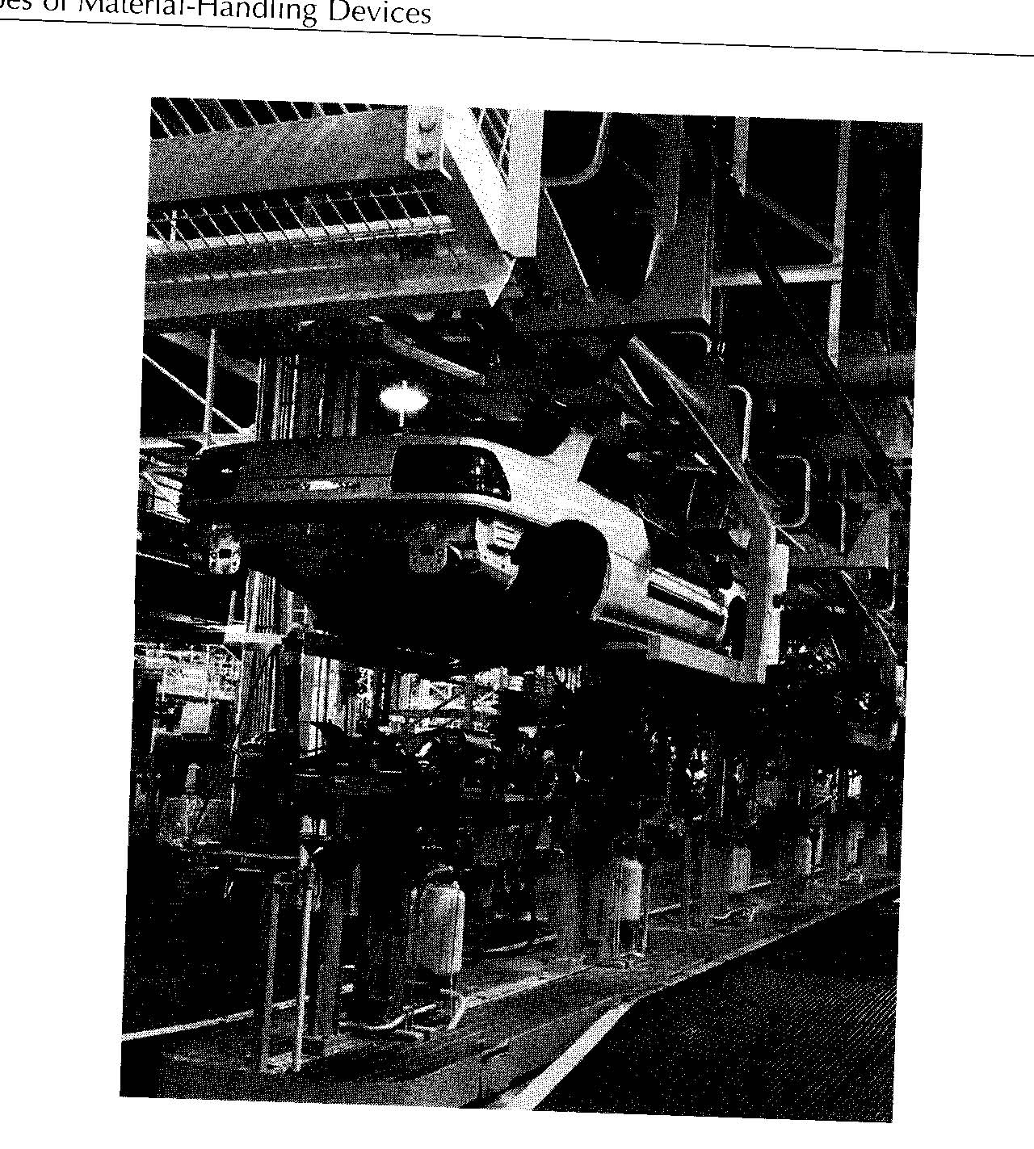
Synchronous Transfer Lines
Production is paced by an interconnecting conveyor system
No WIP accumulation at the different stations
Production control logic is hardwired in the supporting conveyor system
Line expensive and inflexible
Typically used for high-throughput final assembly

Slide 22
Asynchronous Flowlines and the Push vs. Pull dilemma
Part advancement between the different stations is not synchronized.
Need for buffering capacity at the different stations to accommodate the resulting WIP.
Two primary control mechanisms
  Push:
    Lots are released into the line according to an externally specified production plan.
    A lot that has completed processing at its current station will immediately advance to the next one.
  Pull:
    Target WIP levels are specified for different line segments.
    Lot advancements that can cause the exceeding of some target WIP levels are blocked.
    A drop from the target WIP level is a signal for replenishment.

Slide 23
Asynchronous Flowlines and the Push vs. Pull dilemma (cont.)
Push properties
  Directly connected to production planning
  Can easily accommodate changes in target production
  (In its basic definition), it lacks a feedback mechanism that can facilitate reaction to operational contingencies
  As a result, congestion is possible

Slide 24
Asynchronous Flowlines and the Push vs. Pull dilemma (cont.)
Pull properties
  Main control variable is WIP
  The enforced WIP caps make the line reactive to contingencies and prevent congestion
  Need for some (analytical) machinery to translate target production plans to target WIP levels
  Need considerable stability of the production plans, since frequent changes of the target WIP levels can lead to chaotic behavior.

Slide 25
Asynchronous Transfer Lines
W1
W2
W3
TH
TH
TH
TH
B1
M1
B2
M2
B3
M3
Some important issues:
What is the maximum throughput that is sustainable through this line?
What is the expected cycle time through the line?
What is the expected WIP at the different stations of the line?
What is the expected utilization of the different machines?
How does the adopted batch size affect the performance of the line?
How do different detractors, like machine breakdowns, setups, and maintenance, affect the performance of the line?

Slide 26
KANBAN-based production lines
Station 1
Station 2
Station 3
Some important issues:
What is the throughput attainable by a certain selection of KANBAN levels?
What is the resulting cycle time?
How do we select the KANBAN levels that will attain a desired production rate?
How do we introduce the various operational detractors into the model?

Slide 27
CONWIP-based production lines
Station 1
Station 2
Station 3
FGI
Some important issues:
Same as those for the KANBAN model, plus
How can we compare the performance of such a system to that of an asynchronous transfer line and/or a KANBAN-based system?

Slide 28
Tentative Course Outline
Introduction: Course Objectives, Context, and Outline
  Manufacturing System as a Transformation Process, Operations Management, and the role of Corporate Strategy
  Contemporary high-volume (discrete-part) manufacturing systems and their modeling as stochastic systems
  A taxonomy of the considered manufacturing systems based on their workflow management: Synchronous vs. Asynchronous, and Push vs. Pull and CONWIP models
  Course overview
  The disrupting role of variability and the need for stochastic modeling
Design of Synchronous Manufacturing Systems / Assembly Line Balancing
Modeling, Analysis and Design of Push-Controlled Manufacturing Systems as a series of G/G/m queues
Modeling operational contingencies and some other operational features of the considered facilities
The role of batching in modern production systems and queueing-theoretic modeling of some batched operations
Extension of the results to more complex network structures
Modeling and analysis of CONWIP-controlled manufacturing systems as closed queueing networks
Introduction to (combinatorial) scheduling theory

Slide 29
Analyzing a single workstation with deterministic inter-arrival and processing times
Case I: t_{a} = t_{p} = 1.0
TH
B1
M1
WIP
1
TH = 1 part / time unit
Expected CT = t_{p}
t
1
2
3
4
5
Arrival
Departure

Slide 30
Analyzing a single workstation with deterministic inter-arrival and processing times
Case II: t_{p} = 1.0; t_{a} = 1.5 > t_{p}
TH
B1
M1
WIP
Starvation!
1
TH = 2/3 part / time unit
Expected CT = t_{p}
t
1
2
3
4
5
Arrival
Departure

Slide 31
Analyzing a single workstation with deterministic inter-arrival and processing times
Case III: t_{p} = 1.0; t_{a} = 0.5
TH
B1
M1
WIP
3
2
Congestion!
1
TH = 1 part / time unit
Expected CT → ∞
t
1
2
3
4
5
Arrival
Departure

Slide 32
A single workstation with variable inter-arrival times
Case I: t_{p}=1; t_{a}⇒N(1,0.1²) (c_{a}=σ_{a} / t_{a} = 0.1)
TH
B1
M1
WIP
3
2
TH < 1 part / time unit
Expected CT → ∞
1
t
1
2
3
4
5
Arrival
Departure

Slide 33
A single workstation with variable inter-arrival times
Case II: t_{p}=1; t_{a}⇒N(1,1.0²) (c_{a}=σ_{a} / t_{a} = 1.0)
TH
B1
M1
WIP
3
2
TH < 1 part / time unit
Expected CT → ∞
1
t
1
2
3
4
5
Arrival
Departure

Slide 34
A single workstation with variable processing times
Case I: t_{a}=1; t_{p}⇒N(1,1.0²)
TH
B1
M1
WIP
3
2
TH < 1 part / time unit
Expected CT → ∞
1
t
1
2
3
4
5
Arrival
Departure

Slide 35
Remarks
Synchronization of job arrivals and completions maximizes throughput and minimizes experienced cycle times.
Variability in job inter-arrival or processing times causes starvation and congestion, which respectively reduce the station throughput and increase the job cycle times.
In general, the higher the variability in the inter-arrival and/or processing times, the more intense its disruptive effects on the performance of the station.
The coefficient of variation (CV) defines a natural measure of the variability in a certain random variable.

Slide 36
The propagation of variability
W1
W2
TH
B1
M1
B2
M2
Case I: t_{p}=1; t_{a}⇒N(1,1.0²)
Case II: t_{a}=1; t_{p}⇒N(1,1.0²)
WIP
WIP
3
3
2
2
1
1
t
t
1
2
3
4
5
1
2
3
4
5
W1 arrivals
W1 departures
W2 arrivals

Slide 37
Remarks
The variability experienced at a certain station propagates to the downstream part of the line due to the fact that the arrivals at a downstream station are determined by the departures of its neighboring upstream station.
The intensity of the propagated variability is modulated by the utilization of the station under consideration.
In general, a highly utilized station propagates the variability experienced in the job processing times, but attenuates the variability experienced in the job inter-arrival times.
A station with very low utilization has the opposite effects.

