Slide 1
Chapter 3: Modeling Process Quality
  Describing Variation
    Frequency Distribution & Histogram
    Numerical Summary of Data
    Probability Distribution
  Important Distributions
  Some Useful Approximations

Slide 2
Need for Statistics
Some variation is inevitable in manufacturing processes.
Variation reduction is one of the major objectives in quality control
Variation needs to be described, modeled, and analyzed
How to do it?
Notes:
P4 what is descriptive stat, graphical nature, numerical summary…
P5 what is inferential stat,
Stress the difference between prob and stat. p6 []…

Slide 3
Populations, Samples and Branches of Statistics
Population: a finite, actually existing, well-defined group of objects which, although possibly large, can be enumerated in theory (e.g. investigating ALL the bearings manufactured today).
Sample: A sample is a subset of a population that is obtained through some process, possibly random selection or selection based on a certain set of criteria, for the purposes of investigating the properties of the underlying parent population (e.g. select 50 out of 1,000 bearings manufactured today).
Probability
Population
Sample
Inferential
Statistics
Notes:
P4 what is descriptive stat, graphical nature, numerical summary…
P5 what is inferential stat,
Stress the difference between prob and stat. p6 []…

Slide 4
Graphically Describing Variation
Method 1: Frequency Distribution & Histogram

Slide 5
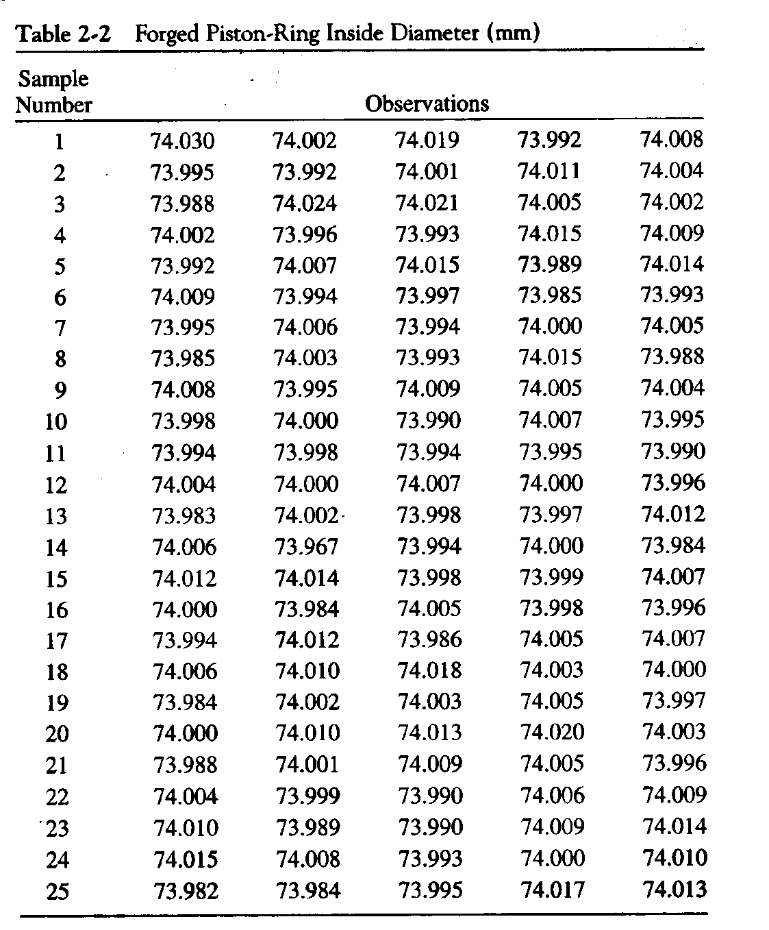
An Example:
Forged Piston Rings for Engines
Variable & Data:
  The inside diameter (Q.C) of forged piston rings(mm)
  125 observations, 25 samples of 5 observations each.
Population
Sample
Observation
Notes:
Piston rings
Piston rings provide a sliding seal between the outer edge of the piston and the inner edge of the cylinder. The rings serve two purposes:
They prevent the fuel/air mixture and exhaust in the combustion chamber from leaking into the sump during compression and combustion.
They keep oil in the sump from leaking into the combustion area, where it would be burned and lost.
Most cars that "burn oil" and have to have a quart added every 1,000 miles are burning it because the engine is old and the rings no longer seal things properly.

Slide 6
Frequency Table & Frequency Histogram
To construct a frequency table
    1. Find the range of the data
      start the lower limit for the first bin just slightly below the smallest data value
      b₀ =min(x), b_{m}=max(x),
    2. Divide this range into a suitable number of equal intervals
      m=4 ~ 20, or (N is the total number of observations)
    3. Count the frequency of each interval
      if b_{i-1}< x ≤ b_{i,}

Slide 7
Histograms – Useful for large data sets
Group values of the variable into bins, then count the number of observations that fall into each bin
Plot frequency (or relative frequency) versus the values of the variable

Slide 10
Interpretation based on the Frequency Histogram
Visual Display of Three Properties of Sample Data
Shape:
  roughly symmetric and unimodal
The center tendency or location
  the points tend to cluster near 450.
Scatter or spread range
  From 413 to 487
Outliers
Notes:
A statistical distribution such as the normal distribution which has a single "peak."

Slide 11
The Box Plot
(or Box-and-Whisker Plot)

Slide 12
Comparative Box Plots

Slide 13
Method 2: Numerical Summary of Data
Definition of Statistic:
  Let x₁, …, x_{n} be a random sample of size n from a population and let T(x₁, …, x_{n}) be a real-valued or vector-valued function whose domain includes the sample space of (x₁, …, x_{n}). Then random variable or random-vector Y = T(x₁, …, x_{n}) is called a statistic.
In short: a statistic is a random value (or a random vector) calculated from a function of a sample of data.

Slide 14
Central Tendency: sample average/mean
Scatter/variability: sample variance or sample standard deviation
Median: A value such that at least 50% of the data values are at or below this value and at least 50% of the data values are at or above this value.
Notes:
Beta1>0
Larger beta 2
smaller beta 2

Slide 15
Example 2 - 1
Calculate the sample mean, median, variance, and standard deviation of a sample of observations: x₁=1, x₂=3, x₃=5.
If x₁=101, x₂=103, x₃=105, is the sample variance different from the first sample?
If x₁=2.5, x₂=3, x₃=3.5, is the sample variance different from the first sample?
If x₃ is 500 instead of 5, what is the sample mean and median of the sample?
Notes:
Bill Gates is x3

Slide 16
Method 3: Probability Distribution
A probability distribution is a mathematical model that relates the value of the variable with the probability of occurrence of that value in the population.
Two types of distributions:
  Continuous: if the value being measured is expressed on a continuous scale
  discrete: if the value being measured can only take on certain values, e.g.. 1,2,3,4,..
f(x)
p(x_{i})
p(x₄)
p(x₃)
p(x₅)
p(x₂)
p(x₆)
p(x₁)
p(x₇)
a
b
x
x₁
x₂
x₃
x₄
x₅
x₆
x₇
x

Slide 17
Review of Probability Distribution Calculation

Slide 18
Probability Density (Mass) Function
A function f (x) (or p(x_{i})) is a p.d.f (or p.m.f) of a random variable x if and only if:
  or
  or
Example 2-2: Suppose that x is a random variable with probability distribution of
Find the appropriate value of k. Find the mean and variance of x. What is the probability of x>0?

Slide 19
Important Distributions
1. Discrete Probability Distribution
    Hypergeometric distribution
    Binomial distribution
    Poisson Distribution
2. Continuous Probability Distribution
    Normal distribution
    Chi-Square distribution
    Student t distribution

Slide 20
Hypergeometric Distribution
Suppose that there is a FINITE population consisting of N items. Some number , say D (D≤N), of these items fall into a class of interest. A random sample of n items is selected from the population without replacement, and the number of items in the sample that fall into the class of interest, say x, is observed.
D
Items of Interest
N
Total # of items
x
~Hypergeomitric
n
(w/o replacement)

Slide 21
Hypergeometric Distribution
Then x is a Hypergeometric random variable with the probability distribution:
Used as a model when selecting a random sample of n items without replacement from a lot of N items of which D are noncomforming or defective
Excel function: HYPGEOMDIST(x,n,D,N)
x=0, 1,…,min(n,D)

Slide 22
Example: Special-purpose circuit boards are produced in lots of size N = 20. The boards are accepted in a sample of n = 3 if all are conforming. The entire sample is drawn from the lot at one time and tested. If the lot contains D=3 nonconforming boards, what is the probability of acceptance?

Slide 23
Example: A lot of size N = 30 contains five nonconforming units. What is the probability that a sample of five units selected at random contains exactly one nonconforming units? What is the probability that it contains one or more nonconformances?
Notes:
Case 1: x=1
Case 2

Slide 24
Binomial Distribution
Bernoulli trial: is an experiment with two and ONLY two possible outcomes, either a “success” (1) or a “failure” (0)
Examples of Bernoulli trials
  Play slot machine (outcome: win/lose)
  Toss coin (outcome: head/tail)
  Going to class (outcome: on time/late)
  Parts produced by a machine (good/defective)
with probability of p
with probability of 1 - p

Slide 25
Binomial Distribution
Binomial Distribution: If n identical (the probability of success on any trial is a constant, p) Bernoulli trials are performed, the number of "success" x in n Bernoulli trials has the Binomial distribution.
, and
Assumption:
(1) Constant probability of success p; (2) Two mutually exclusive outcomes; (3) All trials statistically independent; (4) Number of trials n is known and constant
Application: used as a model when sampling from an infinitely large population. The constant p represents the fraction of defective or nonconforming items in the population
Excel Function: BINOMDIST(x,n,p,false) (True:accumulative probability)

Slide 27
Estimation of Binomial Distribution Parameter
is the ratio of the observed number of defective or nonconforming items in a sample x to the sample size n
the probability distribution of is obtained from the binomial
-> Random number
Notes:
E(p)=E(x/n); E(p)=V(x/n)

Slide 28
Example: Sixty percent of pulleys are produced using Lathe #1, 40% are produced using Lathe #2. What is the probability that exactly three out of a random sample of four production parts will come from Lathe #1 ?
Notes:
1)constant p=0.6
2)two outcome (lath1 or lath2)
3)independent trial samples
4)n=4, x=3

Slide 29
Example: A production process operates with 2% nonconforming output. Every hour a sample of 50 units of product is taken, and the number of nonconforming units counted. If one or more nonconforming units are found, the process is stopped and the quality control technician must search for the cause of nonconforming production. Evaluate this decision rule.
Notes:
Inspection rate=P{x>=1}=1=P(x=0)=1-(50) 0.02⁰(1-.02)⁵⁰=0.6358
(0)

Slide 30
Example: A firm claims that 99% of their products meet specifications. To support this claim, an inspector draws a random sample of 20 items and ships the lot if the entire sample is in conformance. Find the probability of committing both of the following errors:
(1) Refusing to ship a lot even though 99% of the items are in conformance.
(2) Shipping a lot even though only 95% of the items are conforming.
Notes:
Binomial distribution
Case 1: even when p=0.01, the probability of finding some nonconforming unit (x>0) from samples n=20;
Case 2: when the true quality is poor (p=0.05), the miss detection probability of not finding
any nonconforming unit (x=0) from n=20 samples
So, the sample number is this acceptance sampling is not enough

Slide 31
Example: A random sample of 100 units is drawn from a production process every half hour. The fraction of nonconforming product manufactured is 0.03. What is the probability that if the fraction nonconforming is actually 0.03?

Slide 32
Poisson Distribution
Poisson Distribution: the number of random events occur during a specific “time” period with the average occurrence rate λ known:
Examples:
  A. number of random occurrence per unit of time: number of arrivals to McDonald ’s drive-through window from 12:00~1:00pm
  B: number of “defect” per unit of area: number of typographical errors on a page
  C: number of “defect” per unit: number of dents on a car
Assumptions:
  The average occurrence rate λ (per unit) is a known as a constant
  Occurrences are equally likely to occur within any unit of time/area
  Occurrences are statistically independent
Excel Function: POISSON(x,λ, false) (True: cumulative probability)
Notes:
Derive mean and variance

Slide 34
Example: Arrivals of parts at a repair station are Poisson distributed, with a mean rate of 1.2 per day. What is the probability of no repairs in the next day? What is the probability that today the number of parts requiring repair will exceed the average by more than one standard deviation?
Notes:
λ=1.2; x=0

Slide 35
Exercises of Discrete Distributions (1)
What is the distribution of x in the following scenarios?
A production process operates with 2% nonconforming output. Every hour a sample of 50 units of product is taken, and the number of nonconforming units counted as x.
60% of pulleys are produced using Lathe #1, 40% are produced using Lathe #2. A random sample of four production parts containing x parts coming from Lathe #1.
Circuit boards are produced in lots of size 20. The sample of size 3 is drawn from the lot at one time and tested. The lot contains 3 nonconforming boards and x is the number of nonconforming boards in the sample.
Let x be the number of misprints on one page of a daily newspaper, if the average misprints per page is 2.
1000 fish in a pond, 100 of them are tagged. x is # of tagged fish among 5 randomly caught fish

Slide 36
Accidents in a building are assumed to occur randomly with an average rate of 36 per year. There will be x accidents in the coming April.
A book of 200 pages with 2 error pages. There are x error pages in a random selection of 10 pages
The probability that a salesman will make a sale on one call is 0.3. Each day, this salesman makes 10 calls. Let x denote the number of sales made in one day.
The average number of flaws per running yard of a certain type of cotton fabric is 0.01. Let x be the number of flaws in a 100-yard roll of this fabric.
The probability that a basketball player will make a free throw is 0.7. Let x denote the number of free throws he will make in a game of seven free throw attempts.

Slide 37
Normal Distribution
f(x)
σ²
μ
x
Pr(μ−σ≤x≤μ+σ)=68.26%
Pr(μ−2σ≤x≤μ+2σ)=95.46%
Pr(μ−3σ≤x≤μ+3σ)=99.73%
If x₁, x₂ are independently normally distributed variables, then y=x₁+x₂ also follows the normal distribution, i.e. y~N(μ₁+μ₂,σ₁²+ σ₂²)
The Center Limit Theorem: if x₁, x₂, …, x_{n} are independent random variables, with mean μ_{i} and variance σ_{i}², and if y=x₁+x₂+…+x_{n}, then the distribution of z
approaches the N(0,1) distribution as n approaches infinite.
Excel Function: NORMDIST(x,μ,σ,true)

Slide 38
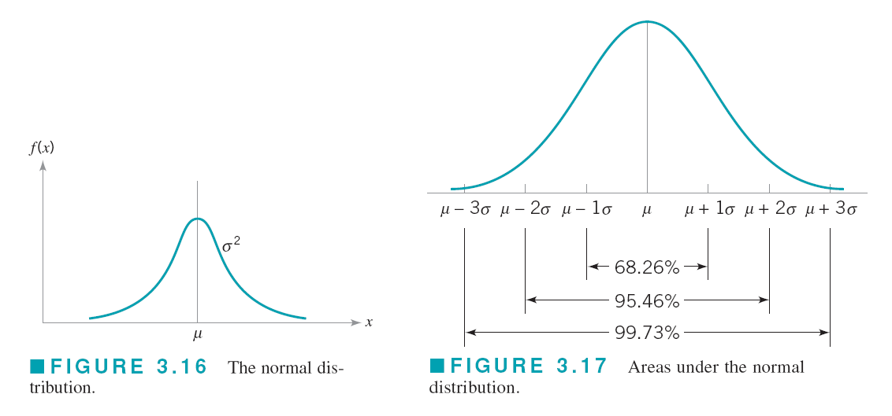

Slide 39
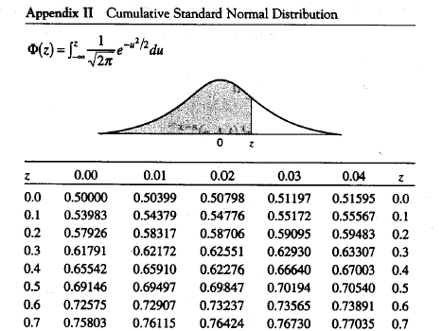
Example 3-3
Notes:
(a) E(y)=25+60+75=160, Var(y)=0.25+0.16+0.09=0.5
Y~N(160,0.5)
(b)
P
(
x
>
1
6
0
.
5
|
μ
=
1
6
0
)
=
1
-
P
(
z
<
1
6
0
.
5
-
1
6
0
0
.
5
)
=1-
Φ
(
1
6
0
.
5
-
μ
σ
)=1−0.7603=0.2398

Slide 40
Example 3-6: Three shafts are made and assembled in a linkage. The length of each shaft, in centimeters, is distributed as follows:
Shaft 1: N ~ (75, 0.09)
Shaft 2: N ~ (60, 0.16)
Shaft 3: N ~ (25, 0.25)
Assume the shafts’ length are independent to each other:
(a) What is the distribution of the linkage?
(b) What is the probability that the linkage will be longer than 160.5 cm?
Notes:
(a) E(y)=25+60+75=160, Var(y)=0.25+0.16+0.09=0.5
Y~N(160,0.5)
(b)
P
(
x
>
1
6
0
.
5
|
μ
=
1
6
0
)
=
1
-
P
(
z
<
1
6
0
.
5
-
1
6
0
0
.
5
)
=1-
Φ
(
1
6
0
.
5
-
μ
σ
)=1−0.7603=0.2398

Slide 42
Chi–Squared Distribution (with degrees of freedom ν)
y>0
Y follows If x₁, x₂, …, x_{n} are normally
and independently distributed random variables

Slide 43
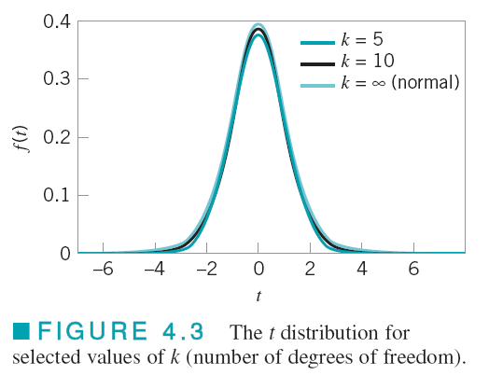
Student t Distribution (with degrees of freedom ν)
Application: If x and y are independent standard normal and chi-square random variable respectively, then is distributed as t with k degrees of freedom.
Used for testing hypotheses about two population means.

Slide 44
F Distribution
(with u and v degrees of freedom)
If w and y are two independent chi-square random variables with u and v degrees of freedom, respectively, then the ratio
is distributed as F with u numerator degrees of freedom and v denominator degrees of freedom.
Used for testing hypotheses about two population variances.

Slide 46
Useful Results on Mean and Variance
If x is a random variable and a is a constant, then
E(a+x)=a+E(x)
E(a*x)=aE(x)
V(a+x)=V(x)
V(a*x)=a²V(x)
If x₁, x₂, …, x_{n} are random variables,
E(x₁+…+x_{n})=E(x₁)+…+E(x_{n})
If they are mutually independent, and a₁,…,a_{n} are constants
V(a₁x₁+…+ a_{n}x_{n})=a₁²V(x₁)+…+a_{n}²V(x_{n})

Slide 47
INTERRELATIONSHIPS BETWEEN DISTRIBUTIONS
Hypergeometric, Binomial, Poisson, Normal
Sampling without replacement
in finite population
Hypergeometric
finite population
if n/N≤0.1
N: population size
n:sample size
p=D/N, n
The sum of a sequence of n Bernoulli trials in infinite population with probability of success p
Binomial
if large n, small p <0.1, or
large n, large p > 0.9, p’=1-p
If np>10 and 0.1 ≤ p ≤ 0.9
μ=np, σ²=np(1-p)
Number of defects per unit
Poisson
if λ ≥15
μ= λ, σ²= λ
Normal

Slide 48
Example: An electronic component for a laser range-finder is produced in lots of size N = 25. An acceptance testing procedure is used by the purchaser to protect against lots that contain too many nonconforming components. The procedure consists of selecting five components at random from the lot (without replacement) and testing them. If none of the components is nonconforming, the lot is accepted. a. If the lot contains three nonconforming components, what is the probability of lot acceptance? b. Calculate the desired probability in (a) using the binomial approximation. Is this approximation satisfactory'? Why or why not? c. Suppose the lot size was N=150. Would the binomial approximation be satisfactory in this case? d. Suppose that the purchaser will reject the lot with the decision rule of finding one or more nonconforming components in a sample of size n, and wants the lot to be rejected with probability at least 0.95 if the lot contains five or more nonconforming components. How large should the sample size n be?

Slide 50
Example: A textbook has 500 pages on which typographical errors could occur. Suppose that there are exactly 10 such errors randomly located on those pages. Find the probability that a random selection of 50 pages will contain no errors. Find the probability that 50 randomly selected pages will contain at least two errors.

Slide 51
Example: A sample of 100 units is selected from a production process that is 2% nonconforming. What is the probability that will exceed the true fraction nonconforming by k standard deviations, where k = 1, 2, and 3?

